Slide 1
pyplot markers 2 14주차_01_04
한 동 대 학 교 김경미 교수

Slide 2
학습목표
기본 Plot 그리기
다양한 Markers 표시
Line reference
Color reference

Slide 3
Matplotlib Markers 3
Line Reference
Marker | Description
'_' | Solid line
':' | Dotted line
'--' | Dashed line
'-.' | Dashed/dotted line

Slide 4
Matplotlib Markers 4
Color Reference
Marker | Description
'r' | Red
'g' | Green
'b’ | Blue
'c' | Cyan
Marker | Description
'm' | Magenta
'y' | Yellow
'k' | Black
'w' | White

Slide 5
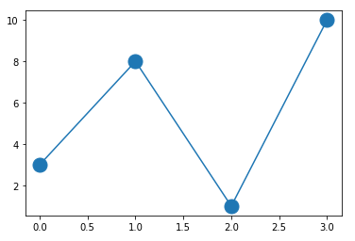
Markers 'o‘ , ms=
import matplotlib.pyplot as plt
import numpy as np
y = np.array([3, 8, 1, 10])
plt.plot(y, marker = 'o', ms = 15)
plt.show()

Slide 6
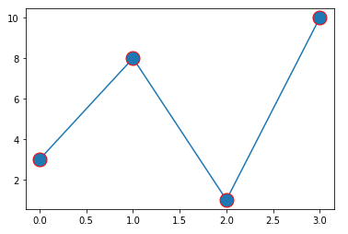
Markers mec=
import matplotlib.pyplot as plt
import numpy as np
y = np.array([3, 8, 1, 10])
plt.plot(y, marker = 'o', ms = 15, mec = 'r')
plt.show()

Slide 7
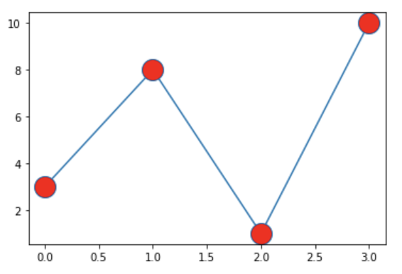
Markers, mfc=
import matplotlib.pyplot as plt
import numpy as np
y = np.array([3, 8, 1, 10])
plt.plot(y, marker = 'o', ms = 20, mfc = 'r')
plt.show()

Slide 8
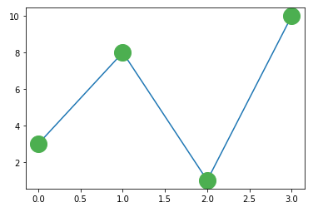
Markers, mec, mfc
import matplotlib.pyplot as plt
import numpy as np
y = np.array([3, 8, 1, 10])
plt.plot(y, marker = 'o', ms = 20, mec = '#4CAF50', mfc = '#4CAF50')
plt.show()

Slide 9
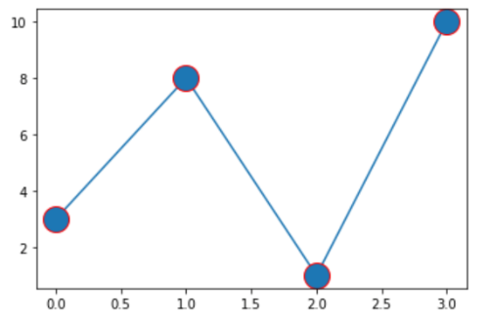
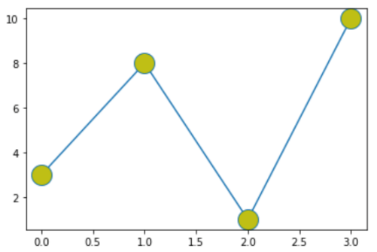
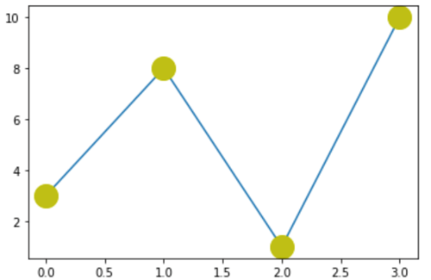
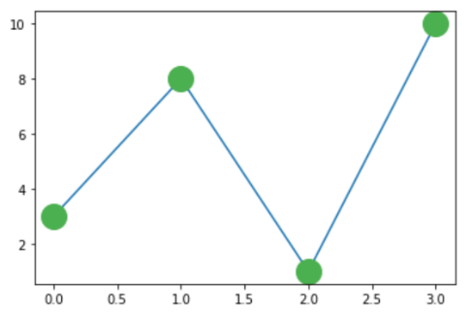
연습문제 1
아래 코드의 알맞은 출력 결과는?
import matplotlib.pyplot as plt
import numpy as np
y = np.array([3, 8, 1, 10])
plt.plot(y, marker = 'o', ms = 20, mec = 'y', mfc ='y')
plt.show()

Slide 10
연습문제 1 답안
아래 코드의 알맞은 출력 결과는?
import matplotlib.pyplot as plt
import numpy as np
y = np.array([3, 8, 1, 10])
plt.plot(y, marker = 'o', ms = 20, mec = 'y', mfc ='y')
plt.show()

Slide 11
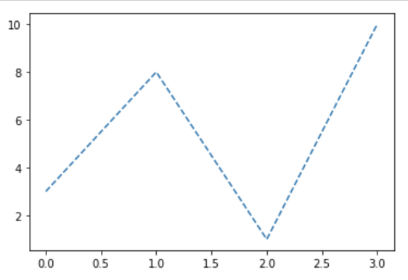
Matplotlib Line style ‘dashed’
표시된 line의 스타일 변경
import matplotlib.pyplot as plt
import numpy as np
y = np.array([3, 8, 1, 10])
plt.plot(y, linestyle = 'dashed')
plt.show()

Slide 12
강의 요약
pyplot marker 이해하기
Markers
ms
mec
mfc

Slide 13
목표 달성 질문
라인이나 마커의 색상을 다음과 같이 지정하려면 어떤 값을 써야하는가?
red
green
black

Slide 14
감사합니다
14주차_01_04 pyplot markers2

